Slide 1
An Energy-efficient Multi-core Restricted Boltzmann Machine Processor with On-chip Bio-plausible Learning and Reconfigurable Sparsity
¹Jiajun Wu, ¹Xuan Huang, ¹Le Yang, ¹Liang Wang, ¹Jipeng Wang, ³Zuozhu Liu, ⁴Kwen-Siong Chong, ²Shaowei Lin and ¹Chao Wang
1. Huazhong University of Science and Technology, Wuhan, China
2. Singapore University of Technology and Design, Singapore
3. National University of Singapore, Singapore
4. Nanyang Technological University, Singapore
Notes:
Hello everyone. Today I’ll introduce our work about An Energy-efficient Multi-core Restricted Boltzmann Machine Processor with On-chip Bio-plausible Learning and Reconfigurable Sparsity.

Slide 2
Outline
Background
Previous RBM Processor
Proposed RBM Processor
Measurement Results and Comparison
Conclusions and Future Works
Notes:
I will introduce this work as the following six sections. Firstly, the background including RBM model, learning rule and application will be presented. Then, several previous works will be discussed. Next, I’ll briefly introduce the advanced algorithm called VPF, which is selected as our learning rule of RBM processor. After that, the design and implementation details of the proposed RBM processor will be presented. Then I will discuss the test results and performance comparison. Finally, I will make conclusion and talk about our future works.

Slide 3
Outline
Background
Previous RBM Processor
Proposed RBM Processor
Measurement Results and Comparison
Conclusions and Future Works
Notes:
Let’s begin with background of our work.

Slide 4
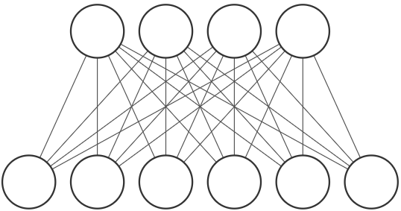
Background (1/2)
Restricted Boltzmann Machine (RBM)
1
0
0
1
Hidden Layer
1
0
1
1
1
0
Visible Layer
Binarized vector
Reconstructed vector
Traditional learning rule - Contrastive Divergence (CD)
Generative model
Unsupervised learning
Sparse connection
Notes:
Restricted Boltzmann Machine is a mature machine learning model. As we can see in this figure, it is a binarized and generative model. A basic RBM model consists of two layers, which are named as visible layer and hidden layer. The connection between two layers is fully-connected. A binarized vector are send into the visible layer, and neural states of the hidden layer are sampled based on weighted summation of the visible layer. This phase is generation. The same sampling is processed again from the hidden layer to the visible layer and this phase is called reconstruction. This sampling process is called Gibbs Sampling. In detail, each neuron accumulates weights of all the synapses connected to it, which is similar to fully-connected layer in Neural Networks. After the accumulated result passes through a non-linear function, the value obtained is compared with a random number to determine whether the state of this neuron is 0 or 1. The learning goal is to make reconstructed vector as similar as possible to the initial vector. Traditional Learning rule of RBM model is Contrastive Divergence that needs two phases of generation and one phase of reconstruction before updating weights. What’s more, sparse connection strategy can be used in RBM model, in which the connections have a certain possibility to be ignore in computation (that is, value of this weight is regarded as 0). In summary, RBM is an unsupervised and generative model. So what are the applications of RBM model?

Slide 5
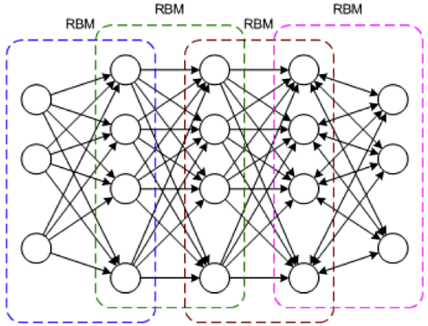
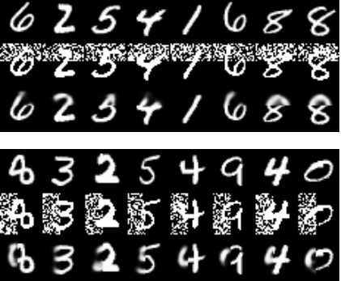
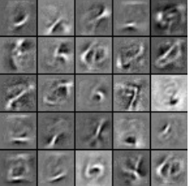
Background (2/2)
Applications of RBM processor
Image Denoising
Feature Learning & Compressive Encoder
Deep Belief Network - Classification
Unsupervised generative model, no labels needed.
In image processing, RBM is often used in occasions where high image resolution is not required, and the application can be completed by using binary images
Notes:
This page presents the typical applications of RBM model. First, a well-trained RBM processor can be used for image denoising. Because the RBM is trained by dataset without noise, the corrupted images that are input into the model will be reconstructed to normal images. Besides, the RBM can be used as compressive encoder because generally the number of hidden neurons is less than the number of visible neurons, so we can use less scale vector to represent the input one. Moreover, deep belief network (DBN) is made up of several basic RBM model, which can be used for image classification and pre-training of fully-connected Neural Networks. All in all, the advantages of RBM model is unsupervised learning rule and binarized data. Unsupervised rule make the training set simpler without labels, while binarized features make RBM qualified to be used in many occasions that don’t need high image resolution.

Slide 6
Outline
Background
Previous RBM Processor
Proposed RBM Processor
Measurement Results and Comparison
Conclusions and Future Works

Slide 7
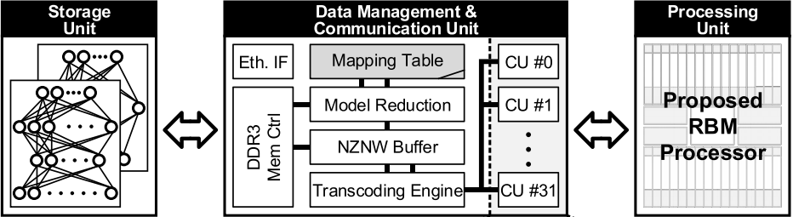
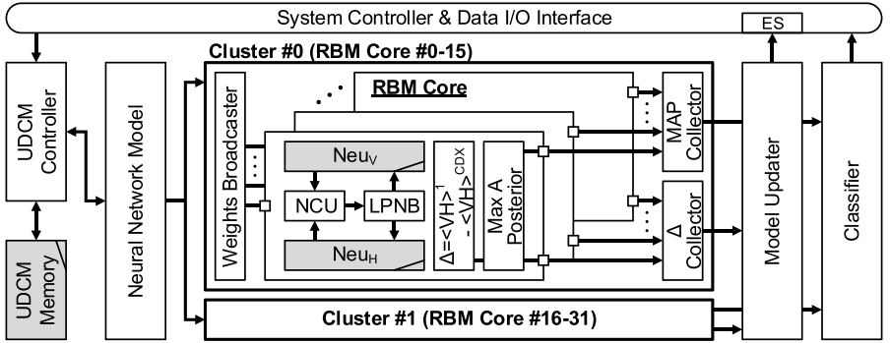
Previous RBM Processor (1/2)
DDR
FPGA
On-Chip
- Need extra devices (FPGA, DDR memory) for data communication
- High bandwidth required
- Ignore the asynchronous computation of different cores
[3] C. Tsai et al., “A 41.3pJ/26.7pJ per neuron weight RBM processor for on-chip learning/inference applications,” Proc. IEEE A-SSCC, pp. 265-268, Nov. 2016.
Notes:
Let’s see some previous works about RBM processors. This work is proposed by National Chiao Tung University. They proposed an on-chip learning RBM processor. But due to the large DDR memory outside the chip, this work needs an FPGA to convert weights from DDR memory to Processor chip, which costs lots of energy consumption and high bandwidth. Moreover, due to large amount of zero values in neuron states and weights, different RBM core achieve different computation speed, but this work ignore the asynchronous computation between RBM cores, which is potential to be optimized and achieves more fast computation and lower energy.

Slide 8
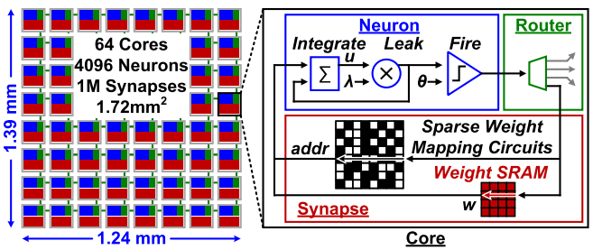
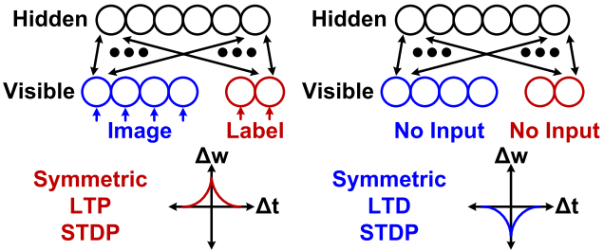
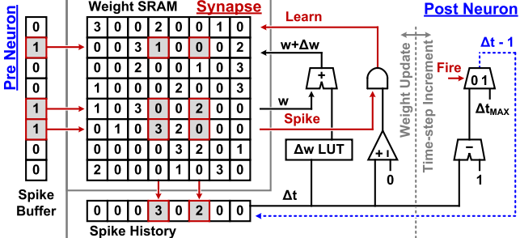
Previous RBM Processor (2/2)
NoC based Spiking RBM processor
Spiking CD, semi-supervised learning
Semi-supervised learning still needs label information.
Large area costs due to LUT based update strategy.
Not fully utilize the optimization for zero values.
LUT based weight update strategy
[4] G. K. Chen et al., “A 4096-neuron 1M-synapse 3.8-pJ/SOP spiking neural network with on-chip STDP learning and sparse weights in 10-nm FinFET CMOS,” IEEE JSSC, vol. 54, no. 4, pp. 992-1002, Apr. 2019.
Notes:
Another previous work of RBM processor is proposed by G. K. Chen in JSSC 2019. It is an NOC architecture and based on spiking neural network. Therefore, the learning rule should be modified to spiking based rule called Spiking CD. It is a semi-supervised learning rule that still needs labels to train. Besides, because of the LUT based update strategy, it has large area consumption for weight update circuit. What’s worse, since there are many zero values in neural states of RBM model that can be skipped to optimize performance. I’ll then introduce our work that solve these bottlenecks of previous works.

Slide 9
Outline
Background
Previous RBM Processor
Proposed RBM Processor
Measurement Results and Comparison
Conclusions and Future Works

Slide 10
Proposed RBM Processor (1/7)
Contributions of our work
Previous problems
Our works
High bandwidth and additional FPGA required
Not fully utilize the zero values and sparsity in RBM model
Ignore the asynchronous computation of different cores
Local weights and local on-chip learning
Pre-generated address for skipping zero neural states and sparse connection.
Energy efficient multi-core architecture that fits for asynchronous computation
Notes:
Now, I’ll introduce our RBM Processor in detail. In the beginning, let me summarize the contributions of our work. Because of High bandwidth and additional FPGA required in previous work, we proposed a local on-chip learning strategy with local weights, instead of encoding and decoding from outside memory. Moreover, we use a pre-generated address way to skip zero neural states and sparse connection, which solved the problem that previous works didn’t fully utilize lots of zero values and sparsity in RBM model. Besides, due to this skip operation, different processing units take different computation time and there are potential chances for optimized asynchronous computation. So, we proposed an energy efficient multi-core architecture that fits for asynchronous computation.

Slide 11
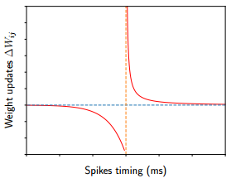
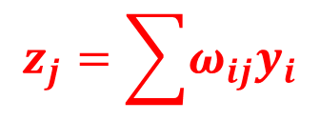
Proposed RBM Processor (2/7)
STDP
$$z_{j}=\sum{ω_{ij}y_{i}}$$
Acceleration!
Advanced learning rule - Variational Probability Flow (VPF)
Bio-plausible and unsupervised learning rule.
Only one generation phase (phase 2) which needs Gibbs Sampling (GS).
[5] Z. Liu et al., “Variational probability flow for biologically plausible training of deep neural networks,” Proc. AAAI 2018.
Notes:
Before introducing our hardware details, I’ll discuss the advanced bio-plausible learning rule we selected. This learning rule is called Variational Probability Flow (VPF). After getting the initial states of visible neurons, there is only one generation phase before its update. That is, RBM model only calculates weighted sum in one phase. Compared with traditional CD algorithm, VPF algorithm takes less computation, and its update function is STDP-like, which is very bio-plausible. All in all, by summarizing the VPF and CD algorithms, we can conclude that in RBM model, the highest computation stage is weighted summation. Therefore, the main acceleration is focused on weighted summation in our RBM Processor.

Slide 12
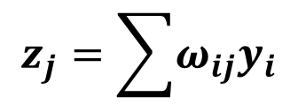
Proposed RBM Processor (3/7)
$$z_{j}=\sum{ω_{ij}y_{i}}$$
V->H generation
H->V reconstruction
P × P RBM cores and N × N AGS cores. P and N are constrained by hardware resource.
Local data movement through horizonal bus and vertical bus instead of the whole architecture.
Notes:
Firstly, I’ll introduce our proposed energy efficient multi-core architecture that fits for asynchronous computation.
We set up our RBM Processor with parameters P and N. N is equal to the number of neurons that are mapped into every RBM core. That is, each AGS core is responsible for weighted summation and Gibbs sampling of a certain visible or hidden neuron. The whole weighted summation is divided into partial sums and each RBM more in the same horizonal or vertical bus is responsible for calculating one partial sum. Then the bus will accumulate the partial sums to AGS cores. This architecture can achieve faster computation speed because the potential asynchronous computation we mentioned before. Different RBM cores calculate partial sums with different time due to many zero values and sparse connections in RBM model. So the fast RBM core doesn’t need to wait for the slow cores for accumulation, but send the partial sums to AGS core asynchronously. As this figure presents, we design horizonal and vertical bus for generation from visible layer to hidden layer, and hidden layer to visible layer, respectively. This strategy is different from previous works that we use mapping solution to avoid data movement in the whole architecture, and limit them in certain same buses to decrease power consumption.

Slide 13
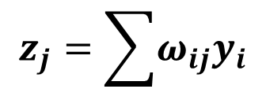
Proposed RBM Processor (4/7)
$$z_{j}=\sum{ω_{ij}y_{i}}$$
P
RBM cores in the same row contain the same hidden neurons (HN #1~N)
RBM cores in the same column contain the same visible neurons
Notes:
Based on the multi-core architecture, how we map the RBM model to hardware? We use this example to illustrate it. As we can see in this figure, an M × M RBM model is mapped in to our RBM processor. For example, we want to calculate the weighted summation of first hidden neuron in the V to H generation phase, which contains M times of multiply and add. We divide these computation into several parts, and calculate them in different RBM cores, then accumulate them asynchronously by bus to corresponding AGS core. the same as the second hidden neuron. Similar mappings and calculations are done in H to V reconstruction phase. Therefore, we map N visible neurons, N hidden neurons and N × N weights into an RBM core.

Slide 14
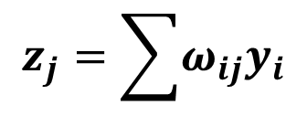
Proposed RBM Processor (5/7)
Architecture and data path of proposed RBM core
$$z_{j}=\sum{ω_{ij}y_{i}}$$
...
...
Summation in parallel
Communication port
Notes:
OK. Let me introduce the details of RBM core. First, we there is a weight memory to store local weights that are mapped in this core. Then, as mentioned before, N hidden neurons and visible neurons are mapped in a core, so we can explore parallel computing in each RBM core. For partial sum of a certain neuron, we use Multiply-adder Core (MAC) to serially calculate it, and expand the computation to all N neurons in parallel. After partial sum in a MAC is completed, this MAC will send the data to bus, with valid-ready handshake protocol. After AGS cores accumulate all partial sums, the total weighted summation and new states sampled by AGS core will be send back to RBM core for weights updating.

Slide 15
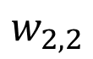
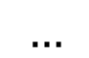
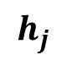
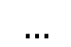
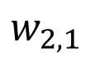
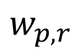
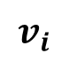
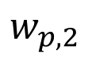
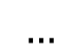
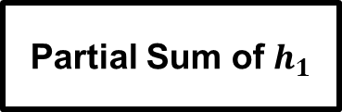
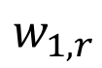
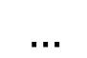
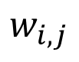
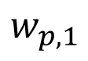
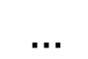
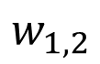
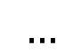
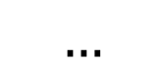
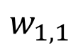
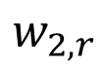
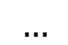
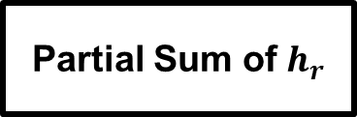
Proposed RBM Processor (6/7)
For RBM core (1, 1), VN #1 ~ #N and HN #1 ~ #N, generation phase:
$$w_{1,1}$$
$$w_{1,2}$$
$$…$$
$$w_{1,r}$$
$$w_{2,1}$$
$$w_{2,2}$$
$$…$$
$$w_{2,r}$$
$$…$$
$$…$$
$$…$$
$$…$$
$$h_{j}$$
$$w_{p,1}$$
$$w_{p,2}$$
$$…$$
$$w_{p,r}$$
Hidden Layer
Serial
Serial
$$w_{i,j}$$
$$…$$
$$…$$
PE #1
$$…$$
PE #r
1
0
Visible Layer
$$v_{i}$$
Partial Sum of $h_{1}$
Partial Sum of $h_{r}$
Notes:
Next, let me briefly introduce the zero skipping strategy while serial accumulation of each MAC. Taking RBM core (1, 1) as an example, where VN #1 ~ #N and HN #1 ~ #N are mapped in. For hidden neuron #1, the MAC #1 will serially take out weights and accumulate them according to pre-generated sparse addresses, that is, not all weights are taken out. The pre-generated addresses are based on neural states and sparsity, to skip zero values and achieve more energy efficient and faster computing. The same strategy is used for other MACs in this RBM core and these MAC calculate partial sums in parallel. So, how these addresses are generated?

Slide 16
Proposed RBM Processor (7/7)
Sparse address
X
Bus Reused for R/W
Support both parallel row- and column-based read.
Notes:
This figure presents the generation circuit that pre-generates the sparse addresses mentioned in last slide. The LFSR module produces the pseudo-random value and compare it with Sparse Threshold Register (STR), which reflects the sparsity ratio (that is, the possibility of each connection to be ignored). If random value is higher than STR value and visible neuron state is 1, the corresponding weight address linked to this visible neuron will be generated and stored in FIFO. These addresses belong to one row or one column. But as we can see in this figure, if we assume the fully-connection weights as a matrix W, the forward generation and backward reconstruction use Matrix W and its transposed matrix to calculate weighted summation. Therefore, a memory that supports reading by both lines and columns are necessary in RBM core. In our implementation, registers arrays are used and for supporting lines and columns reading, there are two sets of data bus and address bus in the Transposed Weights memory.

Slide 17
Outline
Background
Previous RBM Processor
Proposed RBM Processor
Measurement Results and Comparison
Conclusions and Future Works

Slide 18
Measurement Results and Comparison (1/3)
FPGA demo
Evaluation platform
(Sub-sampled MNIST images)
An 100×100 RBM model is implemented with 10×10 RBM cores architecture
Root Mean Square Error (RMSE) is used for evaluation of reconstruction
Signal Noise Ratio (SNR) is used for evaluation of denoising
Notes:
Let me introduce our test platform. We evaluated this work on FPGA with 100 × 100 RBM model and 10 × 10 RBM cores architecture, and used 2 evaluation methods to measure the performance of this work. After training, we use sub-sampled test set of MNIST dataset to evaluate the root mean square error to get the difference between original images and reconstructed images, which reflects the performance of image reconstruction. Besides, signal noise ratio (SNR) is used for evaluation of denoising.

Slide 19
Measurement Results and Comparison (2/3)
Denoising
MNIST with random noise
Reconstructed MNIST
42.5% energy saving contributed by VPF algorithm compared with conventional CD.
29.1% energy saving contributed by 67% sparse connection.
Sparse connection enhances the performance of image denoising.
SNR and energy saving based on proposed architecture
Notes:
The function of denoising in a well-trained RBM model is shown in this figure. We further evaluated the sparse connection strategy based on denoising performance. As I introduced before, the sparse connection strategy can decrease energy consumption and model performance, because in which every connection has a certain possibility to be ignore in weighted summation that alleviates overfitting and decreases computation complexity. As this figure shows, if every connection has 67% to be dropped, then our RBM Processor can achieve about 6 dB higher SNR and save 59.2% energy consumption compared with traditional CD learning rule without sparsity.

Slide 20
Measurement Results and Comparison (3/3)
 | C. Tsai [3] A-SSCC 2016 | G. K. Chen [4] JSSC 2019 | This Research
Platform | 65-nm CMOS ASIC | 10-nm FinFET ASIC | 28-nm XC7Z100 FPGA
Learning Rule | CD | Spiking CD | Baseline CD | Proposed VPF
Data Dimension | 4096 neurons per layer | 1024 neurons per layer | 100 neurons per layer | 100 neurons per layer
LUTs | - | - | 175,027 | 184,737
FF | - | - | 169,518 | 194,987
Weight Memory | DDR3 SDRAM | 6T SRAM | FF-based Transpose-RAM | FF-based Transpose-RAM
Weight Bit-width | 16 bits | 7 bits | 8 bits | 8 bits
On-chip SRAM | 128 KB | 1MB | 10KB | 10KB
Clock frequency | 210MHz @1.2V | 506MHz @0.9V | 128MHz @1.8V | 128MHz @1.8V
Learning Energy efficiency | *41.31pJ/NW | 16.8pJ/NW | 112.76pJ/NW | 63.14pJ/NW
Inference Energy Efficiency | 26.74pJ/NW | 8.3pJ/NW | 27.43pJ/NW | 27.43pJ/NW
Learning Throughput | *7.53GNWs/s | 10.3GNWs/s | 7.86GNWs/s | 9.77GNWs/s
Inference Throughput | 26.74pJ/NW | 25.2GNWs/s | 25.12GNWs/s | 25.12GNWs/s
Notes:
After testing the performance, we also summarized hardware measurement results and made some comparison. For fair comparison, we compared CD based implementation with VPF based implementation, both of which are on FPGA. As we can see in this table, VPF based design achieves almost half energy consumption saving and a considerable learning throughput. We will focus on ASIC design in the future, for fair comparison with previous ASIC-based RBM processors.

Slide 21

Outline
Background
Previous RBM Processor
Proposed RBM Processor
Measurement Results and Comparison
Conclusions and Future Works
Notes:
Finally, let me briefly make conclusions and introduce our future works.

Slide 22
Conclusions and Future Work
A multi-core RBM processor design with on-chip learning and reconfigurable sparse connection is proposed to reduce energy consumption and improve processing throughput.
In the future, we will focus on ASIC implementation of our proposed RBM processor to further improve the energy efficiency and minimize the hardware cost. Computing in memory and Global Asynchronous Local Synchronous (GALS) architecture are the potential directions.

Slide 23
Conclusions and Future Work
Thanks for your attention!

